Slide 1


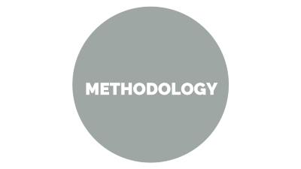



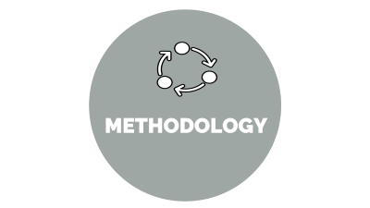




PLANT DISEASE DETECTION

Slide 2

ABSTRACT

Slide 3
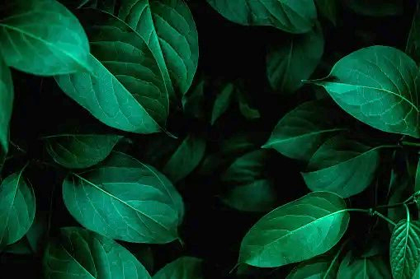

ABSTRACT
Agriculture plays a crucial role in economy, but the various types of disease in plants affects the production of crop so it is necessary to detect the disease in early stage to prevent the significant reduction in yield performance, both in terms of quality and quantity. The proposed plant leaf disease detection system focuses on 14 plant kinds, including apple, blueberry, cherry, maize, grape, orange, peach, pepper, potato, raspberry, soybean, squash, strawberry, and tomato. This system is built on concepts of Deep Learning Convolutional neural networks (CNN) is posted for formation of a statistical model that is executed on the input image and transforms the input to classify output tags.

Slide 4

INTRODUCTION

Slide 5


INTRODUCTION
Agriculture is the backbone of our country around 70% of actual population
depends on agriculture. The Indian economy relies heavily on agriculture
productivity.
A lot is at stake when a plant is struck with a disease that causes a significant loss
in production, economic losses, and a reduction in the quality and quantity of
agricultural products.
It is crucial to identify plant diseases in order to prevent the loss of agricultural
yield and quantity.
Many plants get damaged due to disease, infections which lead to wastage of the
resources where there is large production area
Plant disease Prediction based on Deep learning will surely help to prevent the
same.

Slide 6

PROBLEM STATEMENT AND OBJECTIVE

Slide 7


Problem Statement and Objective
Problem statement
Detection of plant disease
Objectives
To design such system that can detect crop disease accurately and suggest the pest.
To improve the accuracy and reliability of plant disease diagnosis for farmers and agricultural experts
To provide real-time treatment recommendations to farmers to minimize crop losses and improve
agricultural productivity
To address the limitations of existing techniques by expanding the dataset size and diversity, exploring
the use of transfer learning, and improving the interpretability of the machine learning models.

Slide 8
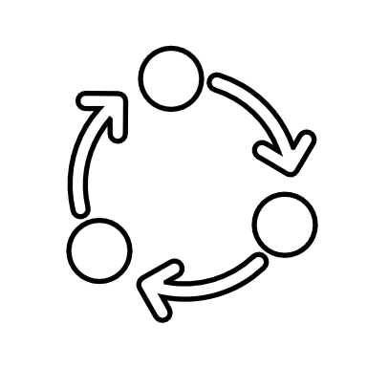
METHODOLOGY

Slide 9


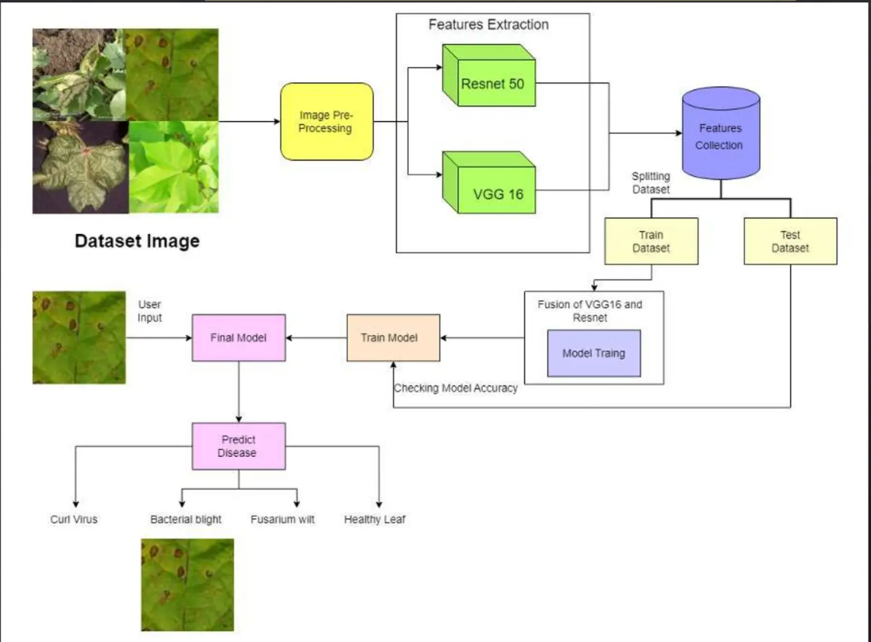
METHODOLOGY

Slide 10

SYSTEM ARCHITECTURE

Slide 11


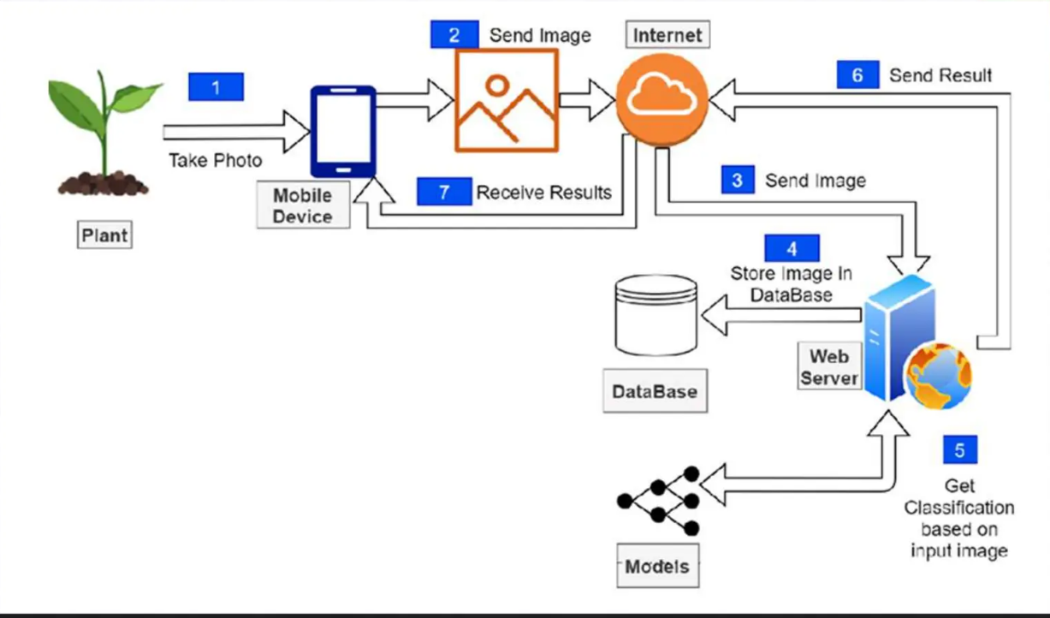
SYSTEM ARCHITECTURE

Slide 12


SYSTEM ARCHITECTURE
The approach for developing the web platform for plant disease prediction using a CNN and algorithm can
be divided into several steps:
1. Data Collection: The first step is to collect a large dataset of plant images, including both healthy and
diseased plants. This dataset will be used to train and validate the deep learning models.
2. Data Preprocessing: The collected dataset will be preprocessed to remove noise and unwanted data. The
images will be resized and normalized to a standard size and format suitable for feeding into the deep
learning models.
3. Model Training: The next step is to train the deep learning models using the preprocessed dataset. Two
deep learning models, namely CNN and ResNet50, will be used. The models will be trained on the
preprocessed dataset using a supervised learning approach.
4. WebPlatform Development: Once the fused model is developed, a web platform will be developed to
make it accessible to farmers. The platform will allow farmers to upload plant images, and the fused model
will predict the type of disease the plant is suffering from.

Slide 13

RESULT

Slide 14

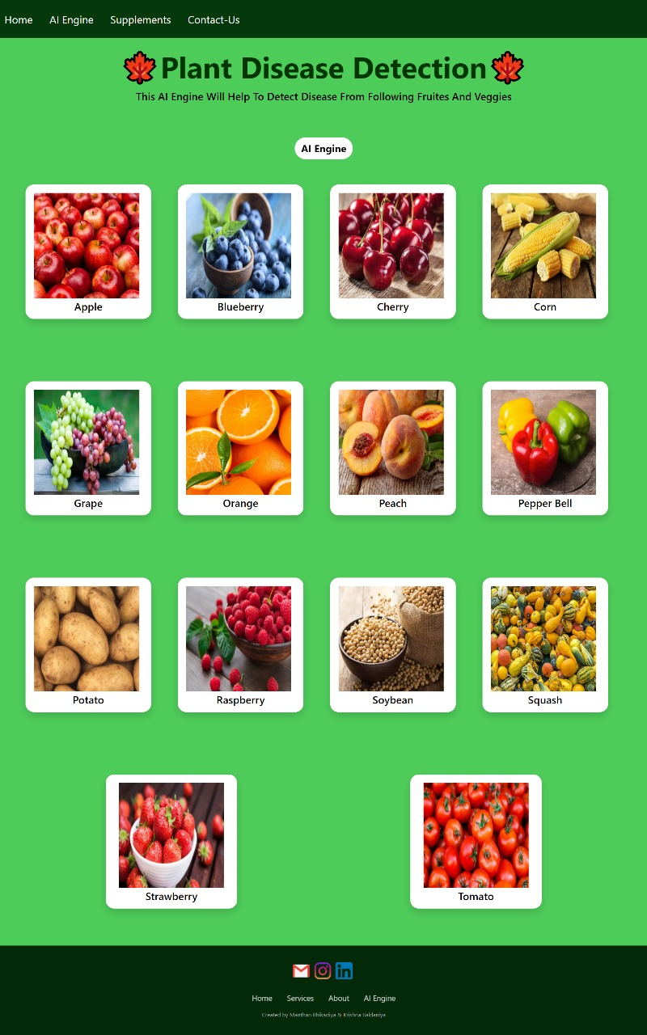
RESULTS
Home page

Slide 15

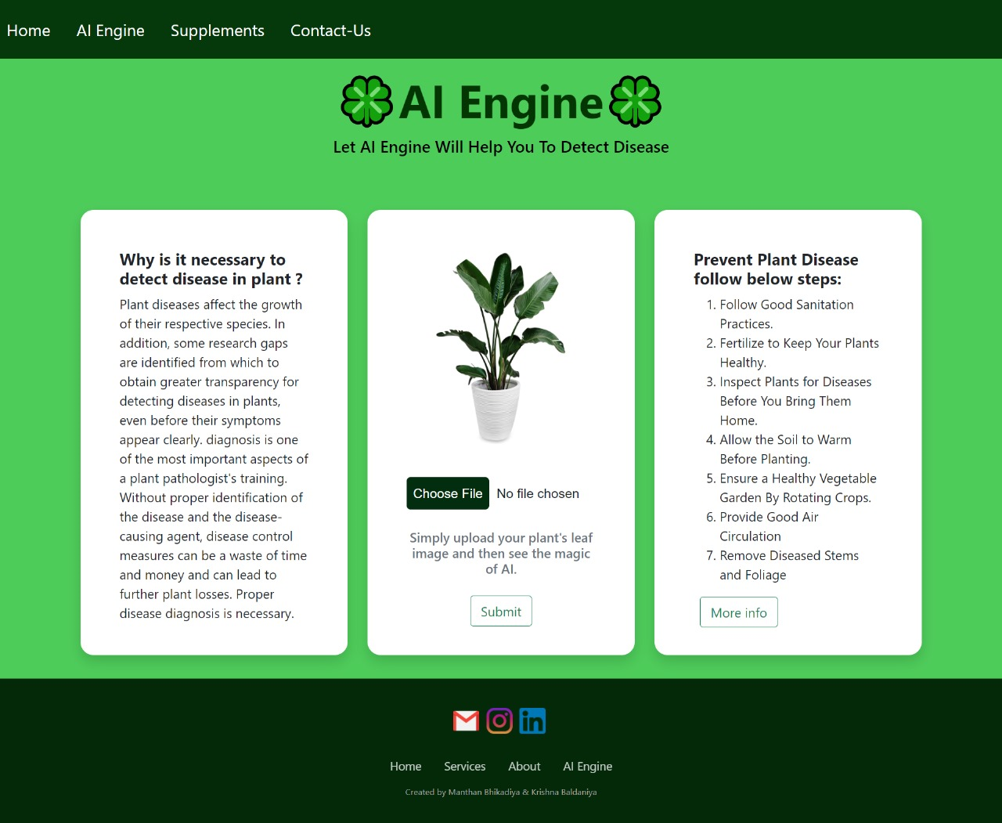
RESULTS
AI Engine page

Slide 16

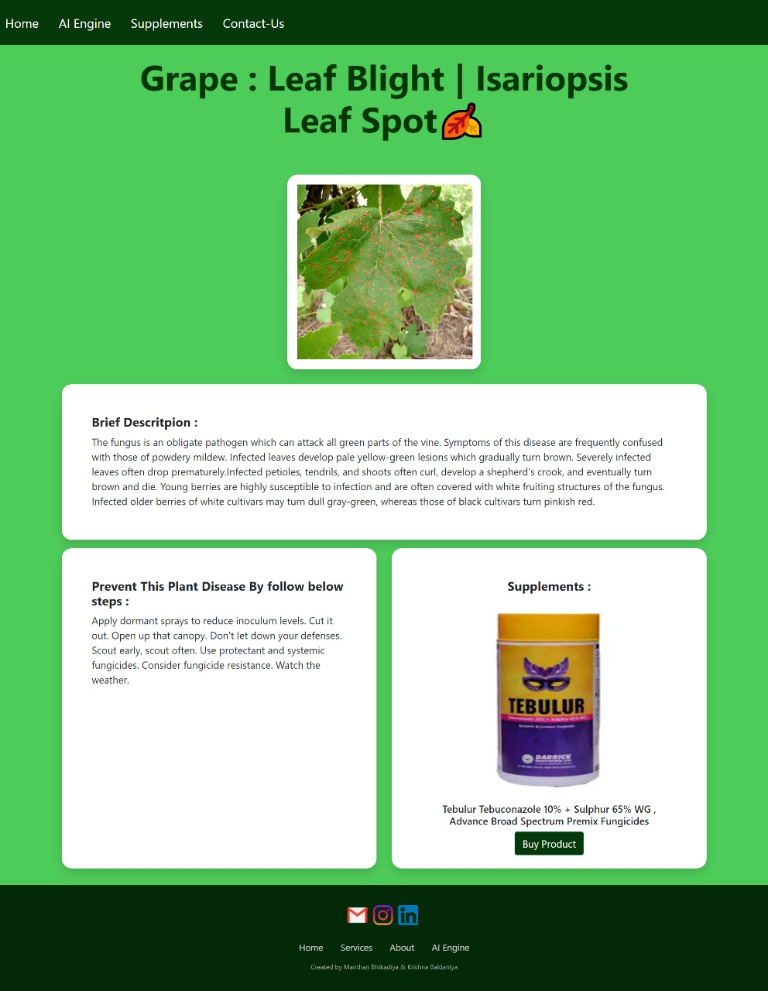
RESULTS
OutCome page

Slide 17


RESULTS
Supplements page

Slide 18

CONCLUSION

Slide 19


CONCLUSION
In conclusion, the application of technology in plant disease detection represents a pivotal advancement in agricultural practices. By harnessing the capabilities of artificial intelligence, machine learning, and computer vision, researchers and farmers alike can identify diseases swiftly and accurately. This proactive approach not only minimizes crop losses but also optimizes resource allocation, leading to improved yield and sustainability in agriculture. As these technologies continue to evolve and become more accessible, the future promises a more resilient agricultural sector capable of feeding a growing global population while reducing environmental impact. Embracing innovation in plant disease detection is therefore crucial for ensuring food security and sustainable farming practices in the years to come.

